Slide 1
Chapter 18 : Concurrency Control

Slide 2
Lock-Based Protocols
A lock is a mechanism to control concurrent access to a data item
Data items can be locked in two modes :
1. exclusive (X) mode. Data item can be both read as well as written. X-lock is requested using lock-X instruction.
2. shared (S) mode. Data item can only be read. S-lock is
requested using lock-S instruction.
Lock requests are made to concurrency-control manager. Transaction can proceed only after request is granted.

Slide 3
Lock-Based Protocols (Cont.)
Lock-compatibility matrix
A transaction may be granted a lock on an item if the requested lock is compatible with locks already held on the item by other transactions
Any number of transactions can hold shared locks on an item,
But if any transaction holds an exclusive on the item no other transaction may hold any lock on the item.
Notes:
If a lock cannot be granted, the requesting transaction is made to wait till all incompatible locks held by other transactions have been released. The lock is then granted.

Slide 4
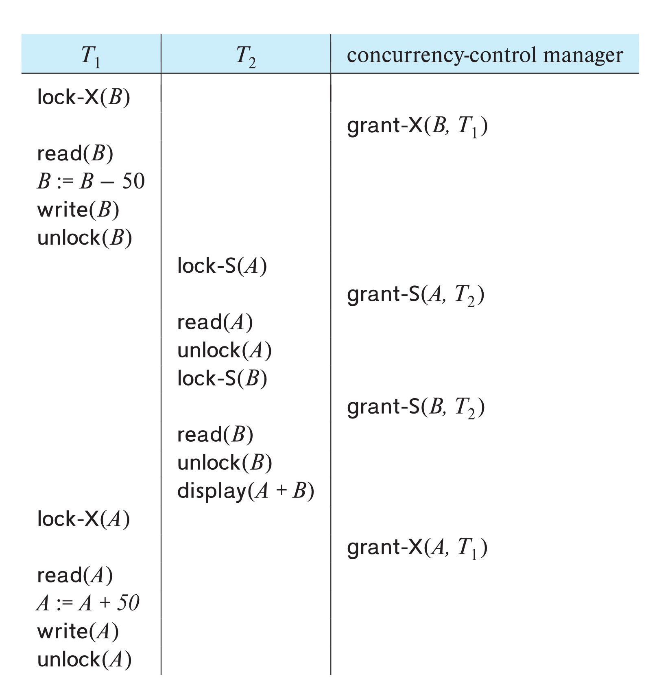
Schedule With Lock Grants
Grants omitted in rest of chapter
Assume grant happens just before the next instruction following lock request
This schedule is not serializable (why?)
A locking protocol is a set of rules followed by all transactions while requesting and releasing locks.
Locking protocols enforce serializability by restricting the set of possible schedules.

Slide 5
Concurrency Control Techniques
Two basic concurrency control techniques:
Locking,
Timestamping.
Both are conservative approaches: delay transactions in case they conflict with other transactions.
Optimistic methods assume conflict is rare and only check for conflicts at commit.

Slide 6
Locking
Transaction uses locks to deny access to other transactions and so prevent incorrect updates.
Most widely used approach to ensure serializability.
Generally, a transaction must claim a shared (read) or exclusive (write) lock on a data item before read or write.
Lock prevents another transaction from modifying item or even reading it, in the case of a write lock.

Slide 7
Locking - Basic Rules
If transaction has shared lock on item, can read but not update item.
If transaction has exclusive lock on item, can both read and update item.
Reads cannot conflict, so more than one transaction can hold shared locks simultaneously on same item.
Exclusive lock gives transaction exclusive access to that item.

Slide 8
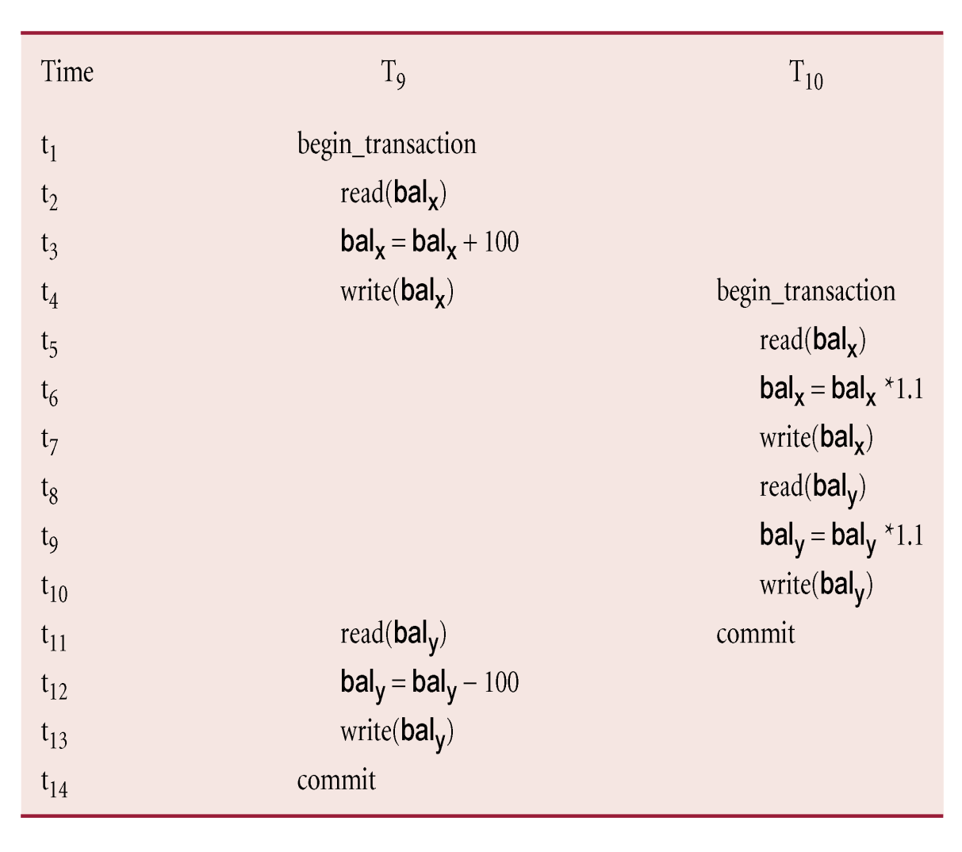
Example -

Slide 9
Example - Incorrect Locking Schedule
For two transactions above, a valid schedule using these rules is:
S = {write_lock(T₉, bal_{x}), read(T₉, bal_{x}), write(T₉, bal_{x}), unlock(T₉, bal_{x}), write_lock(T₁₀, bal_{x}), read(T₁₀, bal_{x}), write(T₁₀, bal_{x}), unlock(T₁₀, bal_{x}), write_lock(T₁₀, bal_{y}), read(T₁₀, bal_{y}), write(T₁₀, bal_{y}), unlock(T₁₀, bal_{y}), commit(T₁₀), write_lock(T₉, bal_{y}), read(T₉, bal_{y}), write(T₉, bal_{y}), unlock(T₉, bal_{y}), commit(T₉) }

Slide 10
Example - Incorrect Locking Schedule
If at start, bal_{x} = 100, bal_{y} = 400, result should be:
bal_{x} = 220, bal_{y} = 330, if T₉ executes before T₁₀, or
bal_{x} = 210, bal_{y} = 340, if T₁₀ executes before T₉.
However, result gives bal_{x} = 220 and bal_{y} = 340.
S is not a serializable schedule.

Slide 11
Example - Incorrect Locking Schedule
Problem is that transactions release locks too soon, resulting in loss of total isolation and atomicity.
To guarantee serializability, need an additional protocol concerning the positioning of lock and unlock operations in every transaction.

Slide 12
Two-Phase Locking (2PL)
Transaction follows 2PL protocol if all locking operations precede first unlock operation in the transaction.
Two phases for transaction:
Growing phase - acquires all locks but cannot release any locks.
Shrinking phase - releases locks but cannot acquire any new locks.

Slide 13
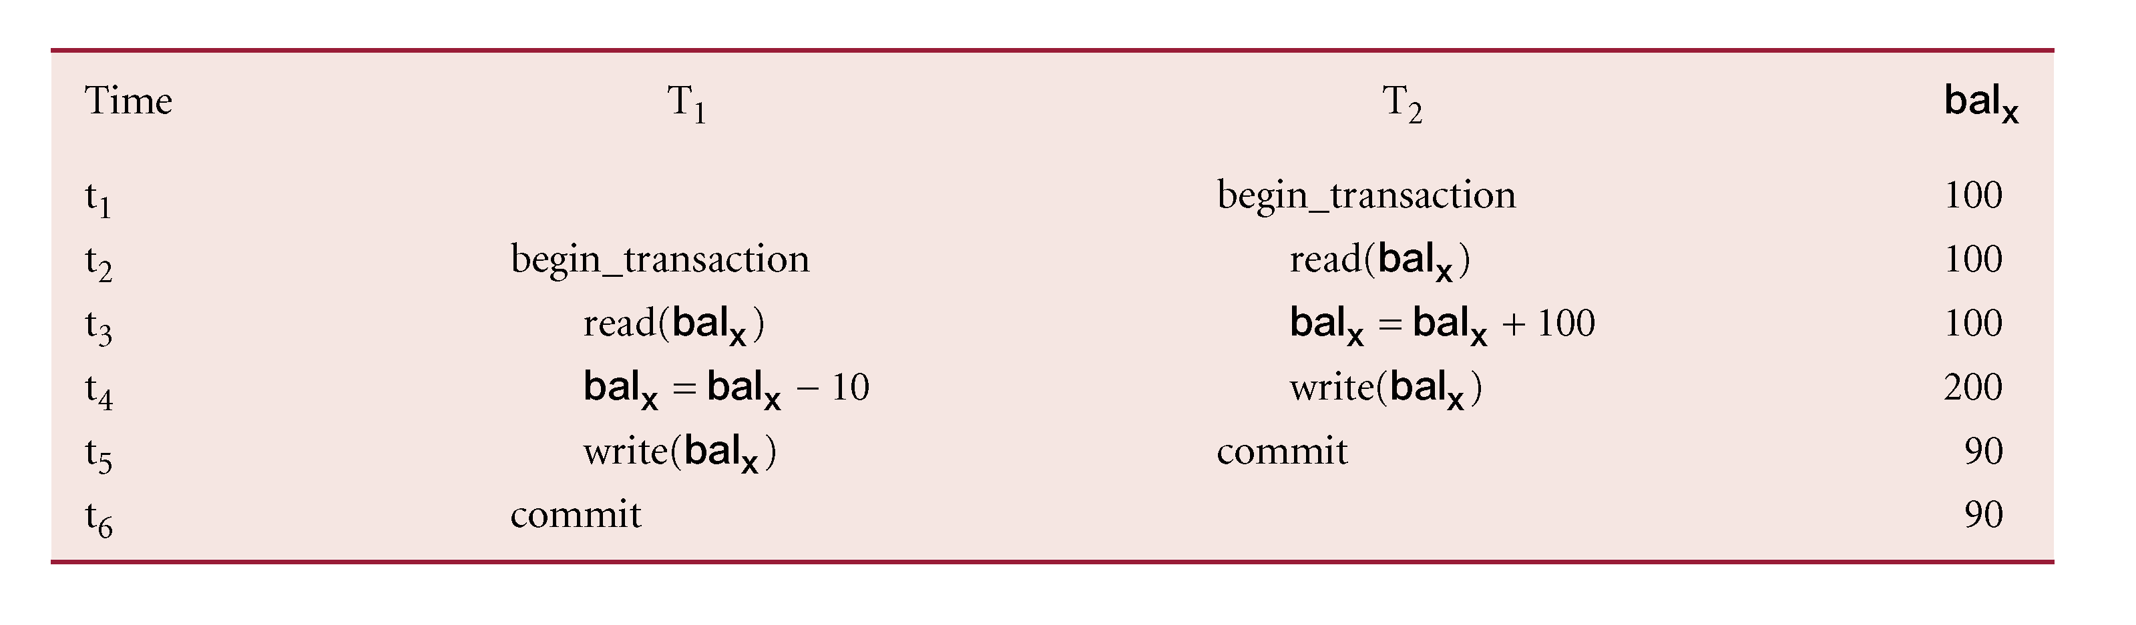
Lost Update Problem
Loss of T₂’s update avoided by preventing T₁ from reading bal_{x} until after update.

Slide 14
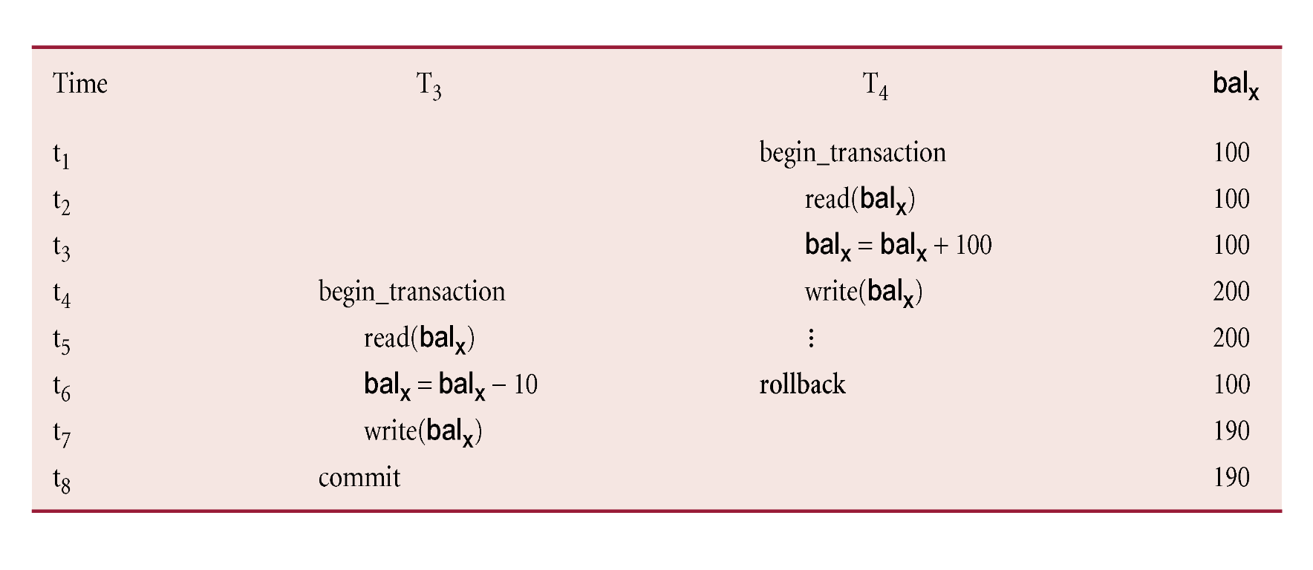
Uncommitted Dependency Problem
Problem avoided by preventing T₃ from reading bal_{x} until after T₄ commits or aborts.

Slide 15
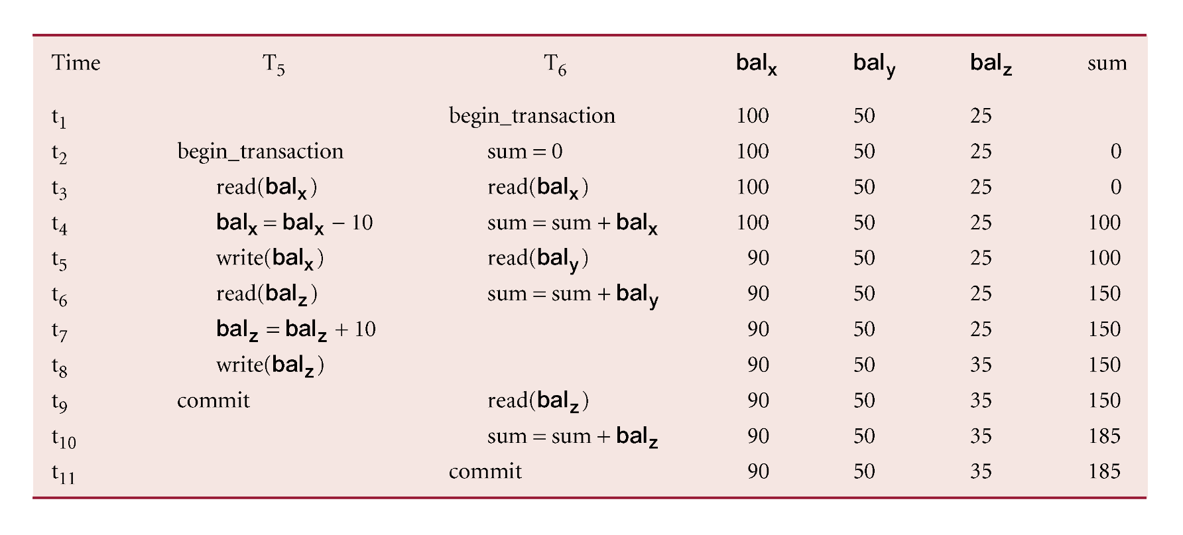
Inconsistent Analysis Problem
Problem avoided by preventing T₆ from reading bal_{x} and bal_{z} until after T₅ completed updates.

Slide 16
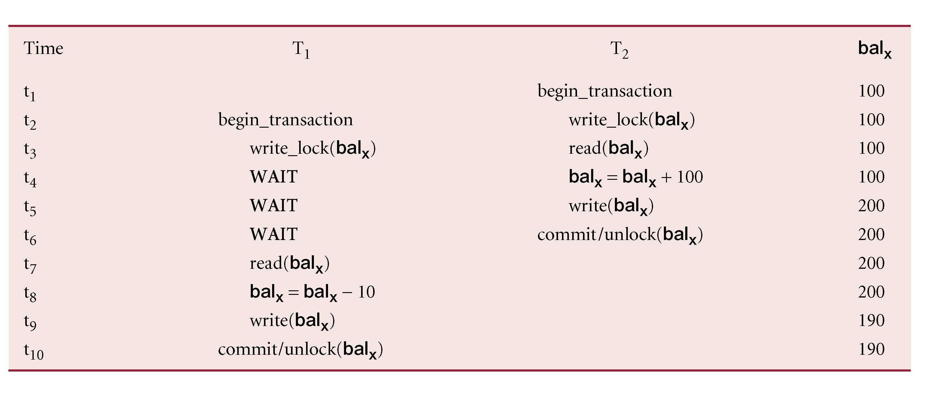
Preventing Lost Update Problem using 2PL

Slide 17
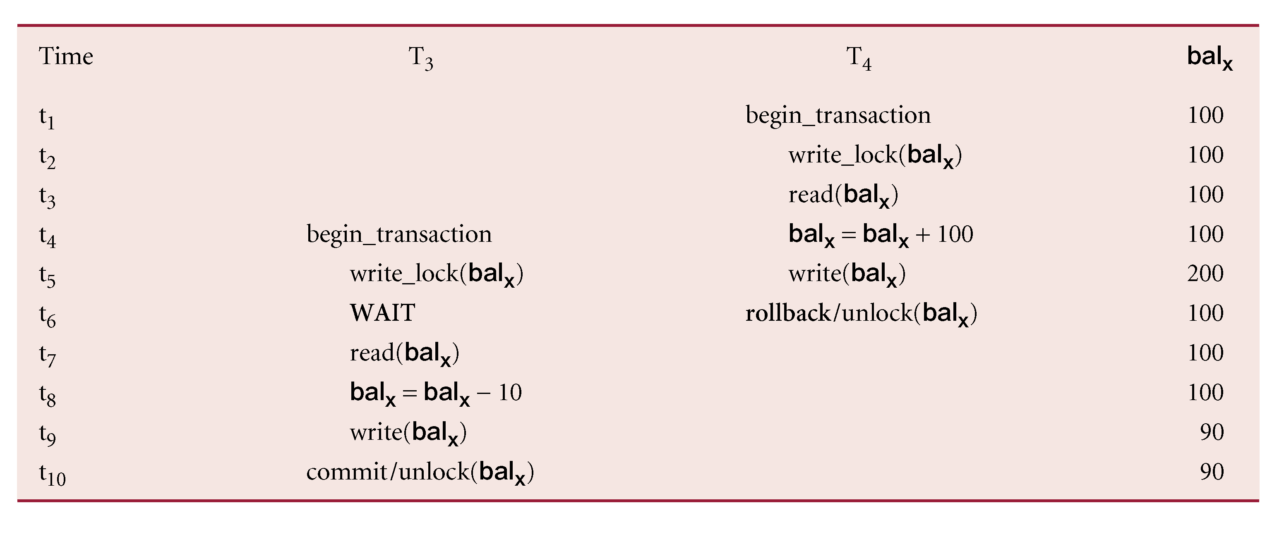
Preventing Uncommitted Dependency Problem using 2PL

Slide 18
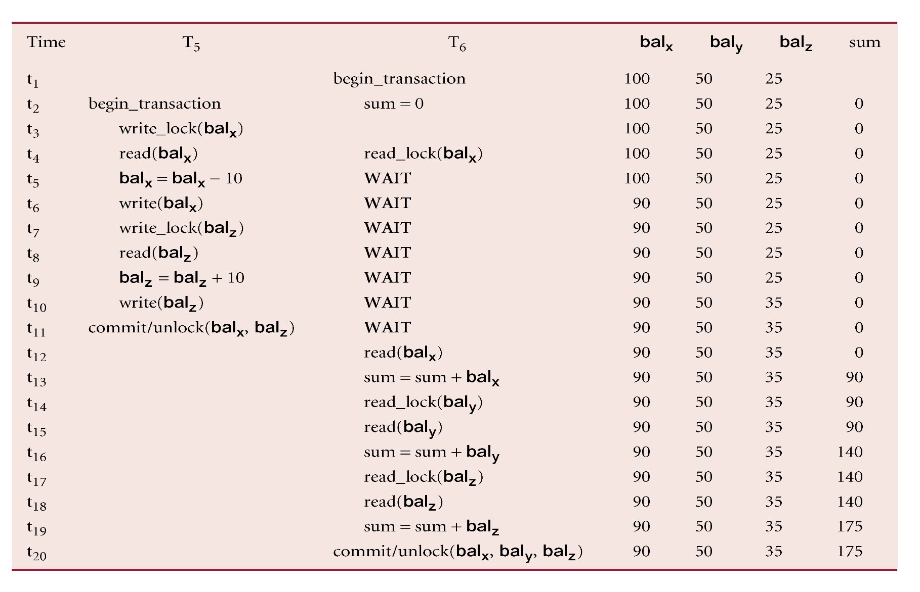
Preventing Inconsistent Analysis Problem using 2PL

